Slide 1
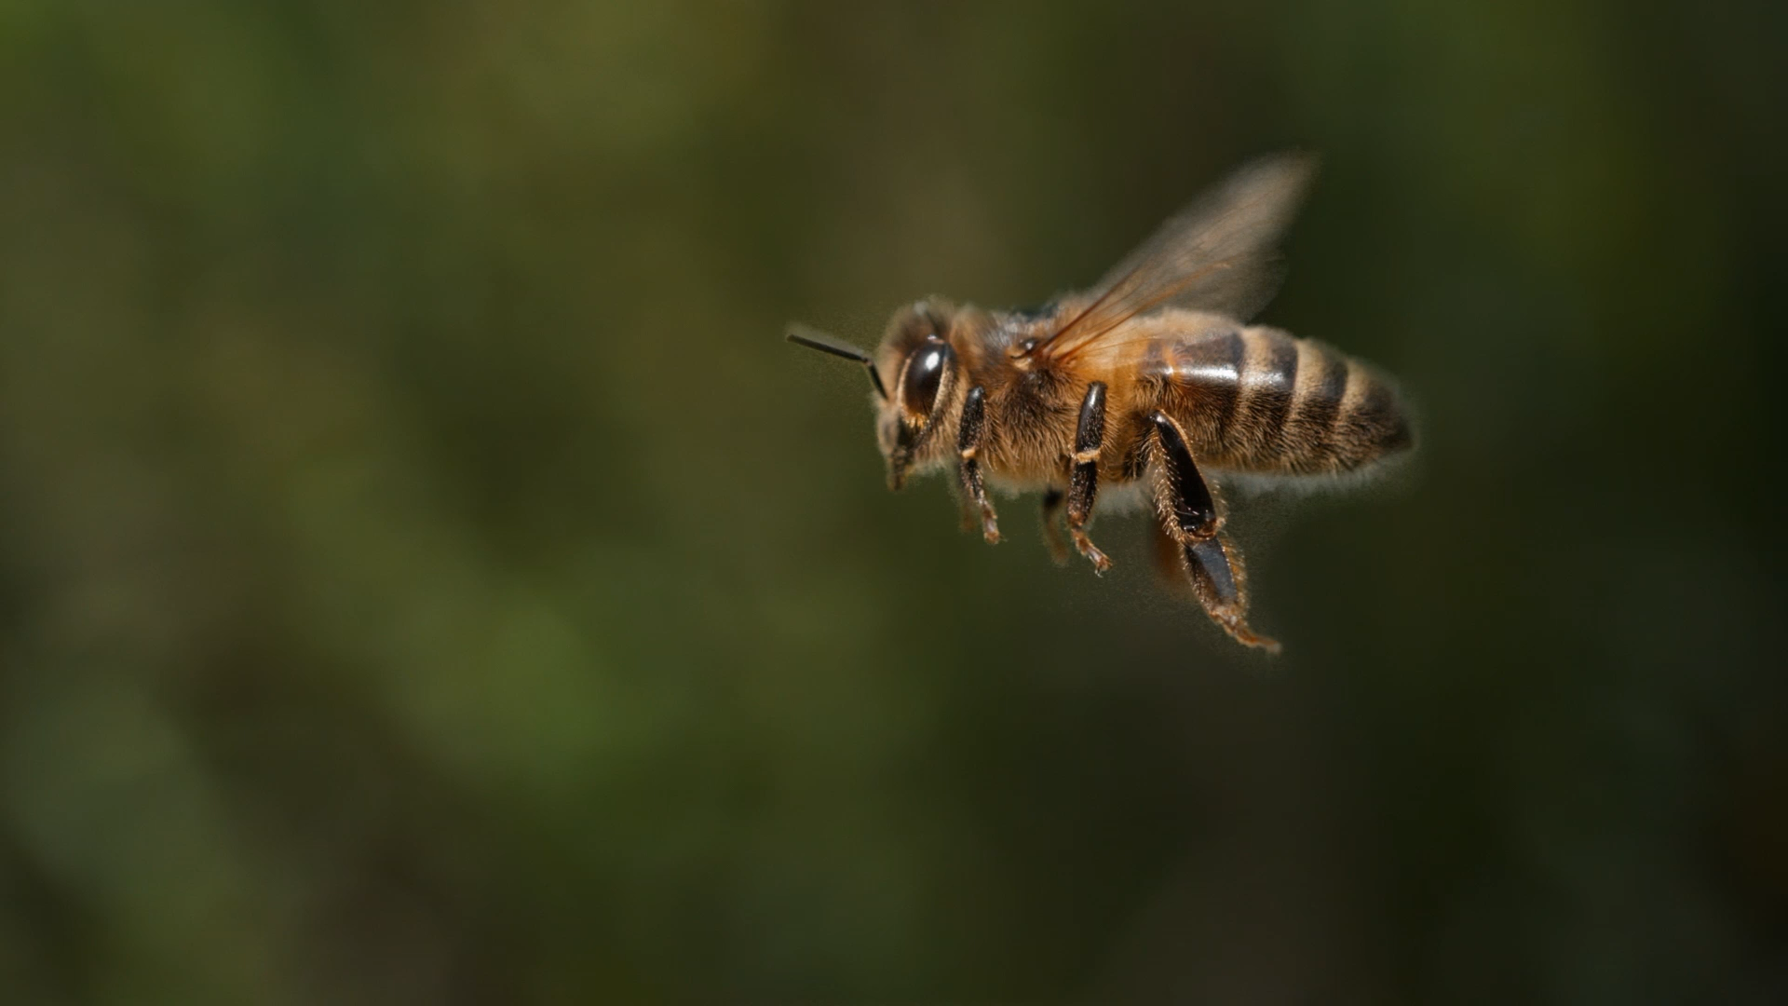
COEN 160 Final Project Spelling Bee
By Kobe Tran
(Individual project)

Slide 2
Table of Contents
Spelling Bee Game Rules / Parameters
How to Win?
Design Ideas
UML Diagram
Activity Diagram
Technologies Used
Code Overview
Demo Time
Output Samples 1-5
Conclusions
References

Slide 3
Spelling Bee Game Rules/Parameters
One Essential Letter: This letter must be included in the word guessed by the player. The letter can be placed anywhere in the word but must appear at least once.
Six random jumble letters: To form a word, other letters need to go along with the essential letter. These jumble letters can appear any number of times or none at all to create a word.
Word Size must be larger than three letters.
Score is determined by word size

Slide 4
How to Win?
If rules are met, find every word that matches in the game’s dictionary using the provided letters presented to you.
Once you matched all the words, you win!

Slide 5
Design Ideas
7 buttons
Essential letter button will be different (shaded orange)
Six regular buttons for the jumble letters
Display field of the word player is trying to guess
Clear Button to clear display field if player made a mistake
Enter Button to submit guessed word for game to check
Message field to notify player of word match found or invalid words

Slide 6
Design Ideas (con.)
Message field will also alert user when player won
Score field to track the points earned
Exit button for user to exit game if a winner
Two Text Areas
List of matched words player already found
How to play message at top of GUI

Slide 7
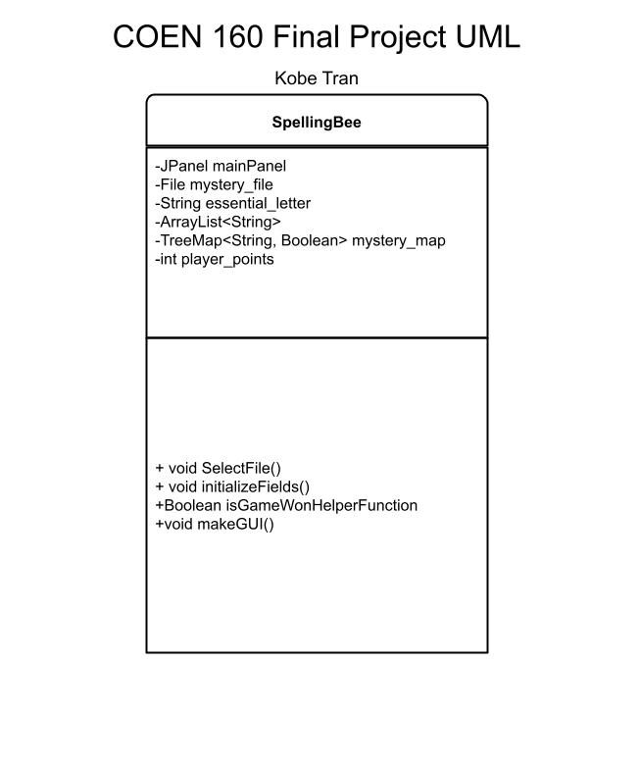
UML Diagram

Slide 8
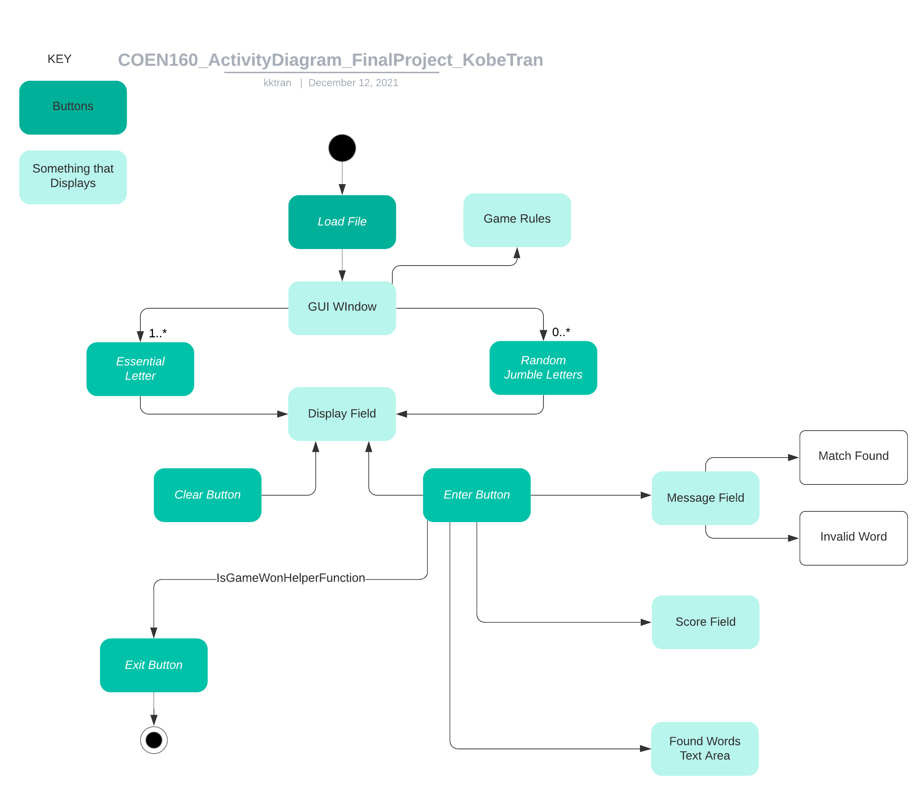
Activity Diagram

Slide 9
Technologies Used
All In Java OO Design And Programming Techniques
No Database (used files instead)

Slide 10
Code Overview
User select a game text file, which outlines letters and word bank in a specific way.
Create a class with fields for the:
Essential Letter
Jumble Letters (stored in ArrayList)
Word Bank (stored in TreeMap)
Object reads file and stores contents in the object’s data structure fields above
GUI uses the data stored in the fields to make the game function properly

Slide 11
Demo Time
Go To Code

Slide 12
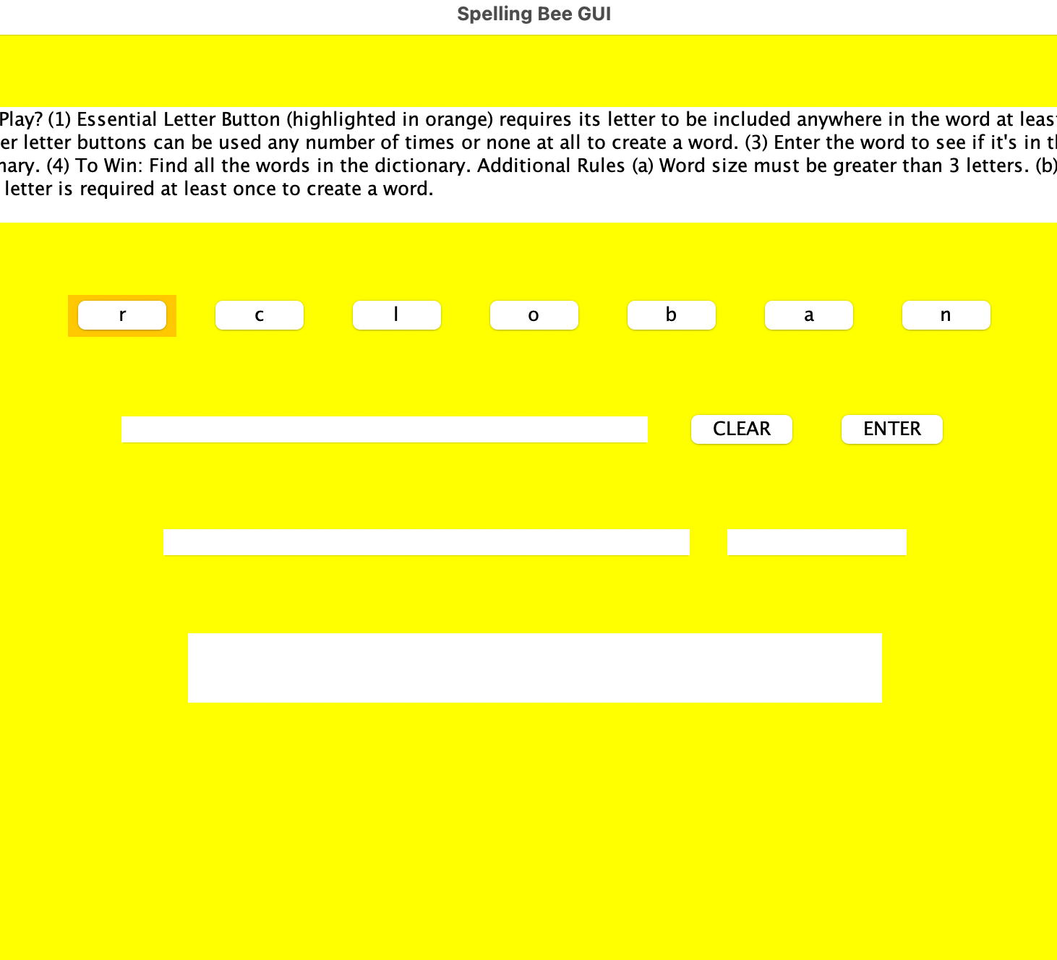
Output Sample 1 (just loaded text file)

Slide 13
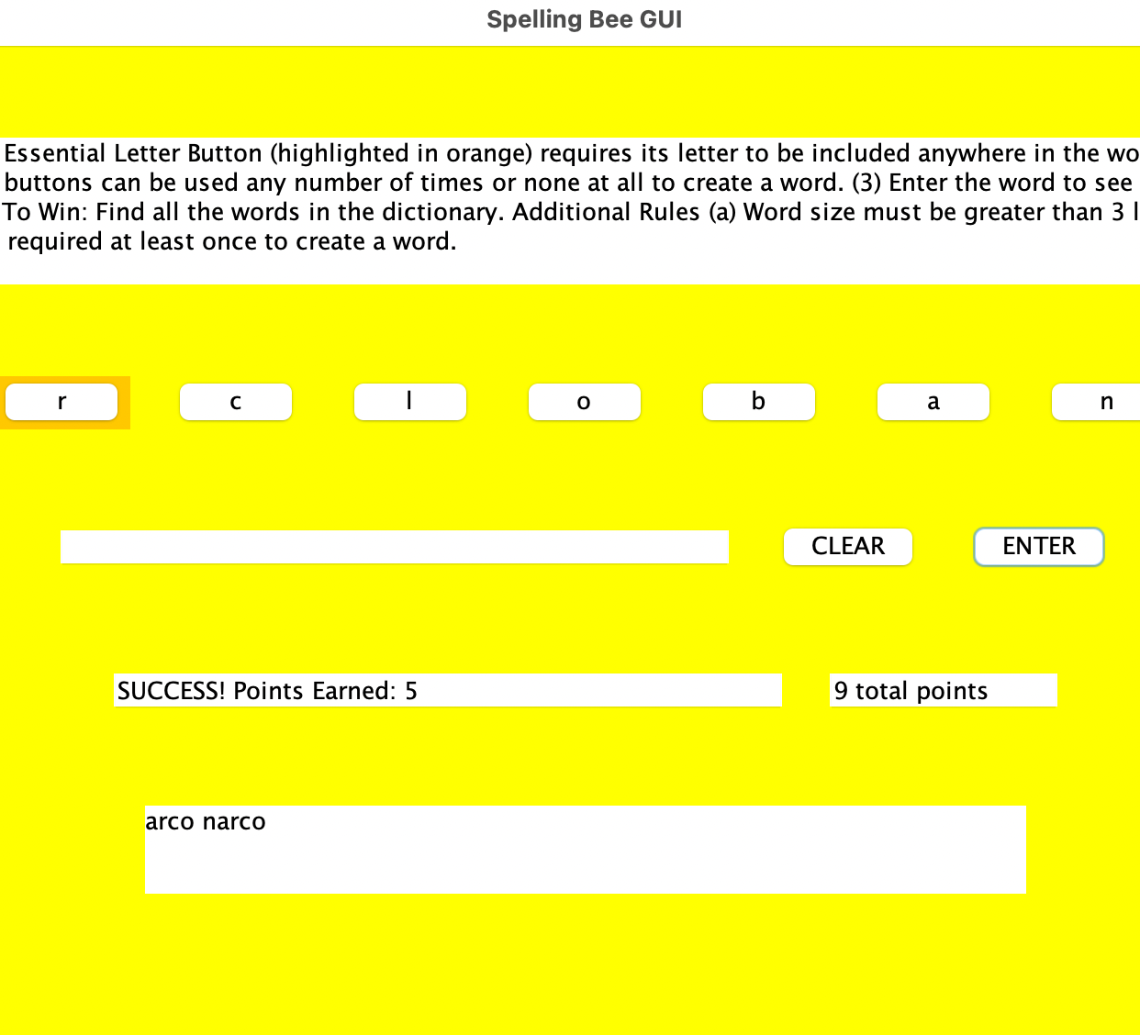
Output Sample 2 (words added)

Slide 14
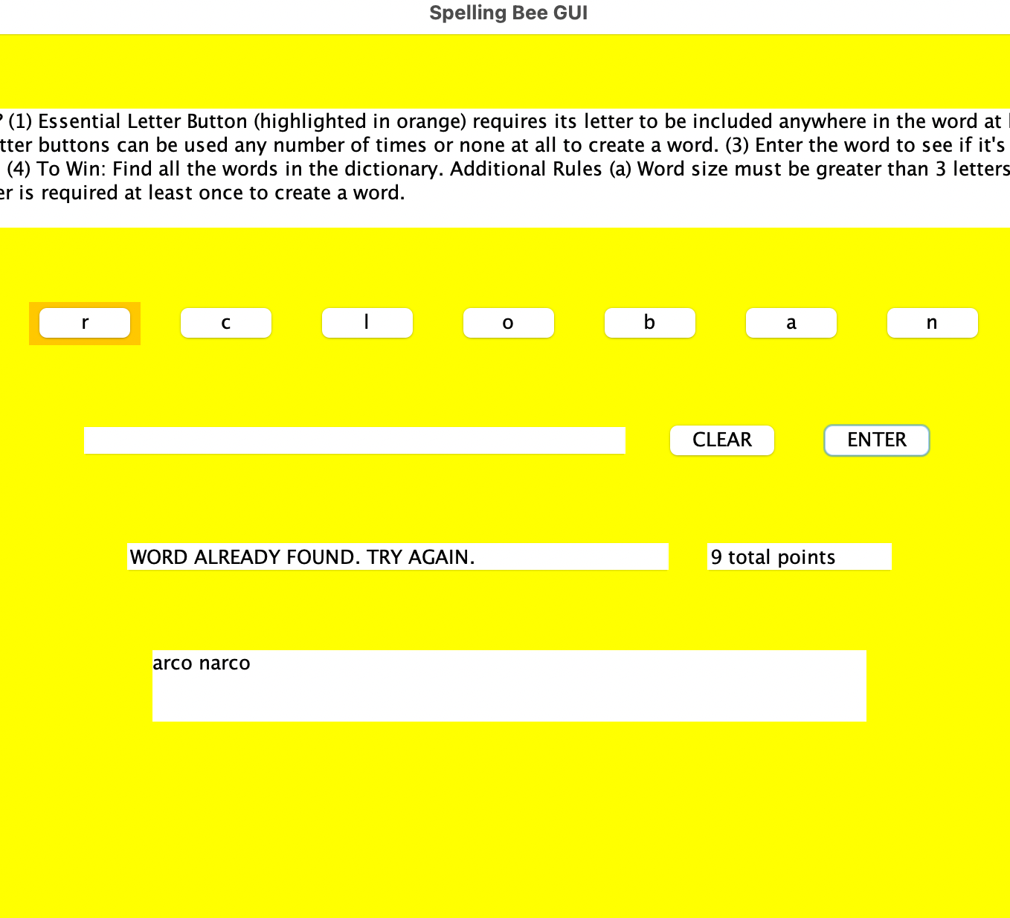
Output Sample 3 (invalid messages)

Slide 15
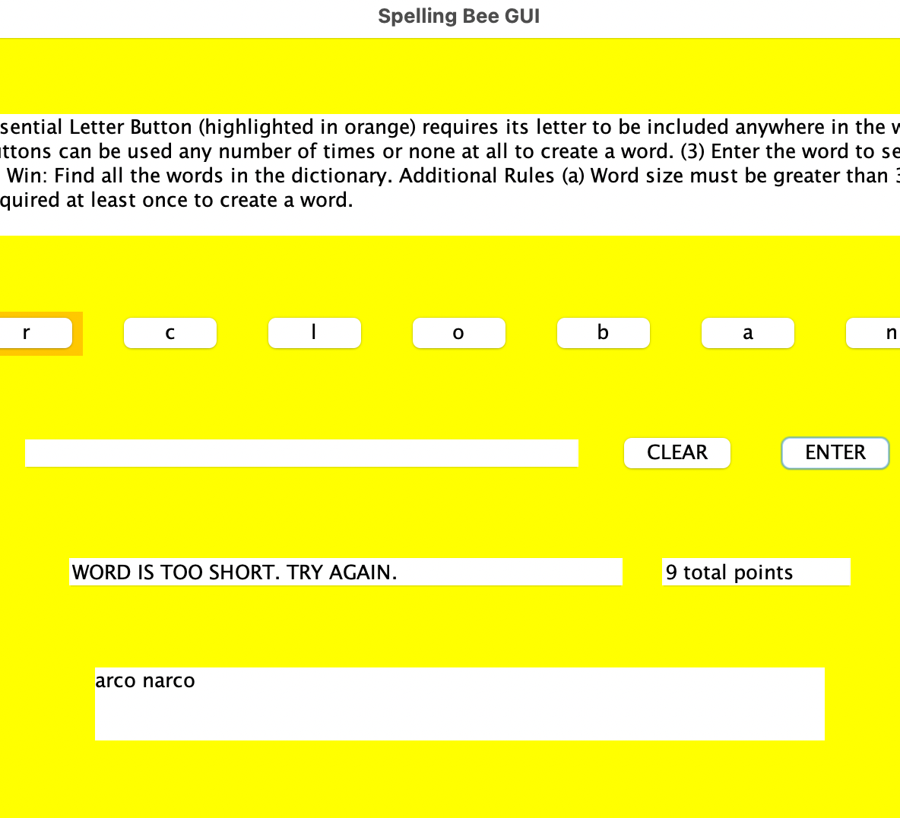
Output Sample 4 (more invalid messages)

Slide 16
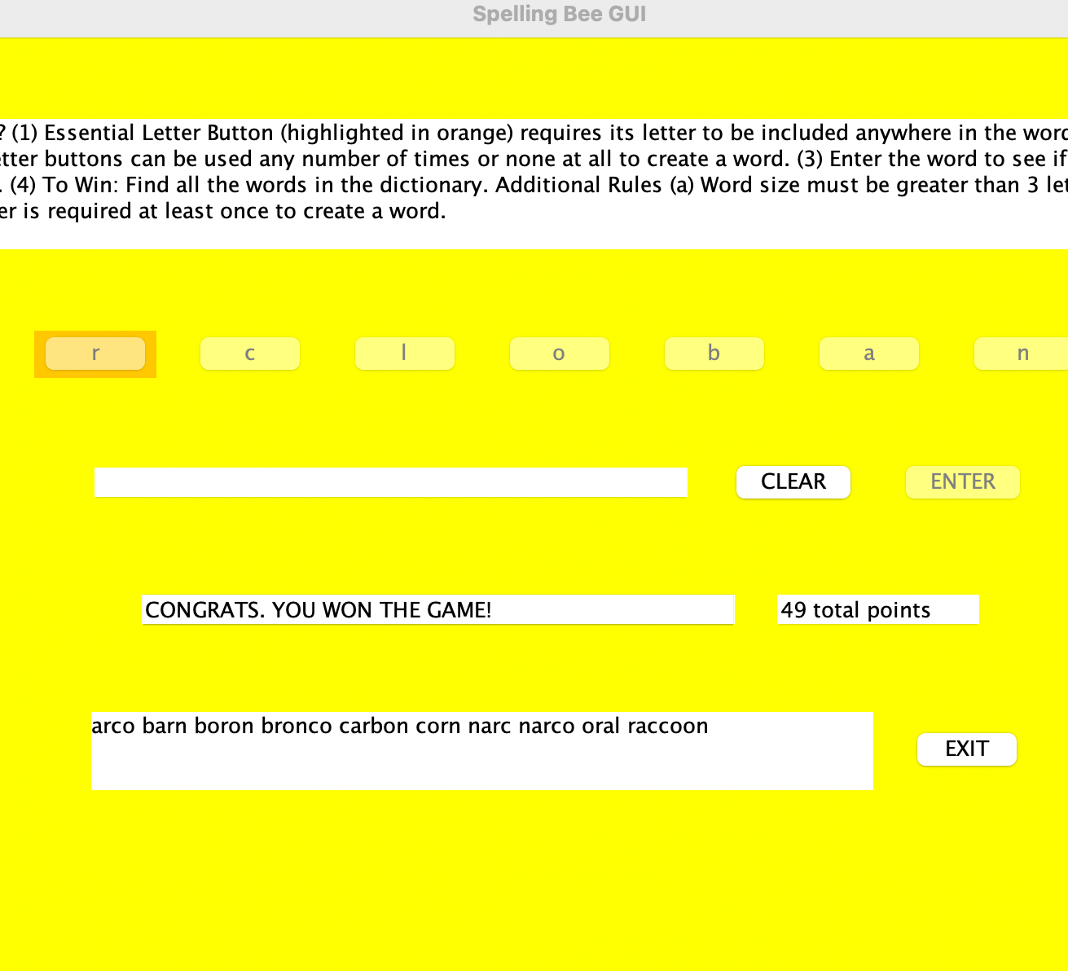
Output Sample 5 (Winner Screen)

Slide 17
Conclusions
Spelling Bee can be easily implemented in Java using
OO design
Files
ArrayList
TreeMap
GUI interfaces
Java is a versatile language that can create a good GUI interfaces for real word applications.
Debugging in Java is easier thanks to both the GUI and terminal to see where errors can arise.

Slide 18
References
https://www.nytimes.com/puzzles/spelling-bee
https://www.w3schools.com/java/java_files_read.asp
https://docs.oracle.com/javase/8/docs/api/java/util/ArrayList.html
https://docs.oracle.com/javase/8/docs/api/java/util/TreeMap.html
Grover, Radhika. Programming With Java A Multimedia Approach.
Grover, Radhika. Lecture Slides. Chapters 9, 10, 11, 12.

